Slide 1
Minimum number of Edge-disjoint circuits that can covers an entire graph
Ankit Petkar - IRM2014002
Surendra Pal Uikey - IWM2014006
Varun Kumar - ICM2014008

Slide 2
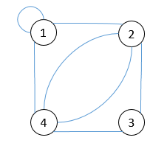
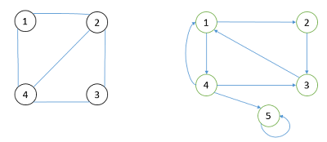
Introduction
An edge-disjoint circuit is a closed walk in which no edge appears more than once but a vertex can be traversed more than once. The given figure shows an example of having circuits as 1-1(self-loop), 1-2-4-1, 2-3-4-2 etc.
As we can see the figure below that though in part (a) the undirected graph has circuit: 1-2-3-4-1 or 1-2-4-1 etc are possible we still can’t cover all the edges , similarly in part (b) the directed graph has circuits: 1-4-1, 1-2-3-1, 5-5, etc. but still the edge from vertex 4 to 5 is not traversed.
(a) Undirected Graph (b)Directed Graph

Slide 3
Algorithm
First check whether graph can be decompose in the edge-disjoint circuit or not. For decomposition all vertex should have the even degree.
V is the vertex in the graph
Loop 1 to V
For undirected
If degree(v) is odd //for undirected
Circuit not possible.
Break.
Goto 10.
For directed
If incoming Degree(v) != outgoing Degree(v)
Circuit not possible.
Break.
Goto 10.
End loop
Otherwise count the circuit in the graph. Goto 6.
Counter = #number of self-loops; (Because self-loop itself create the circuit.)
root = anyone(v1, v2, , vn); (which has some degree.)
if( DFS(root) )
Counter = Counter + 1;
Goto 7 until all the edges in the graph traversed.
finish.

Slide 4
Implementation
1
2
4
3
Graph showing edge-disjoint circuits as 2-2(self-loop), 1-2-4-1, 2-3-4-2 etc.

Slide 5
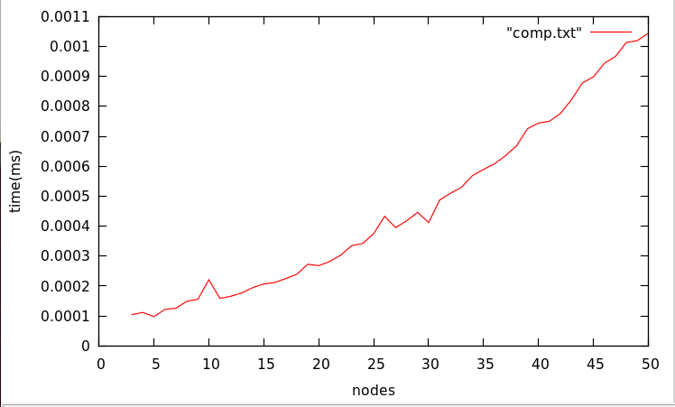
Result and Analysis
As shown in Figure 4 as the number of nodes or vertices increases the execution time also increases. Then the complexities of the applied algorithm are discussed above.
Total number of minimum circuit possible in the graph is total self-loops and the circuit we get from the DFS.
Complexity would be :
V - number of vertex.
E - number of Edges.
Time : O(V*V + V + E).
Space : O(V*V).

Slide 6
Conclusion
Thus applying the above algorithms we get the minimum number of edge-disjoint circuits of a given graph. Complexities of both the algorithms are thus calculated.
Analyzing the time taken vs the number of vertices can be viewed in Figure 4 for undirected graph. The graph shows that conclude that as the number of vertices increases the execution time increases.
Thank You!

